Slide 1
2025 State Capital Outlay – Nonprofits
Department of Municipal Development
Capital Implementation Program
Notes:
Intro
Explain Capital Planner Job
Next slide – what is cap outlay?

Slide 2
Contacts
& introduction
Shawn Maden
CIP Official
SMaden@cabq.gov
505-768-3616
Josh Herbert
CIP Strategic Program Manager
Josh@cabq.gov
505-768-3891

Slide 3
Presentation
goals
Explain the Capital Outlay/State Grant process
Background information
City’s Fiscal Agent process
State’s Online entry

Slide 4
The
Reality
Obtaining funds from the State is a LONG process.
If you need funds between October 2025 and March 2026, your chances are virtually zero
April-Sept 2026 would be incredibly fast, and should not be expected
October 2026-March 2027 funding available is more reasonable
These funds have use/implementation requirements imposed by the State that some organizations consider dealbreakers

Slide 5
What is Capital Outlay?
“Capital Funds” is used unofficially as a catch-all term by public
Source and recipient determine applicable laws
Large sums of funds intended for larger, long term purchases, such as renovations, construction, vehicles, freezers, etc.
Not operating funds or consumables
State Board of Finance is only approving severable equipment and furnishings for NPOs utilizing State Capital, unless the facility to be renovated/constructed is owned by the City.
State minimum of $10,000
Notes:
CR established request amounts, priorities, rules
CIP Ordinance sets timelines
Funds available approx. Mar 2024
Lots of money = lots of rules and direction
Next slide – how projects chosen

Slide 6
The 30,000’ overview
Apply for City to be your Fiscal Agent
Enter Project online to the state
Legislator(s) choose to fund part/all of request
State Bill is passed
State ensures project meets State Law and Anti-Donation clause before funds certified for release
Org & City work with State to get funding certified
State gives City funds
City submits Notice of Obligation
City purchases & provides equipment requested by Org
Org provides public services in lieu of rent/lease payments

Slide 7
Key Takeaways
No project will receive any funding until the State Department of Finance & Administration (DFA) or State Board of Finance (SBoF) certifies that the project meets State law.
Due to the NM Constitution's Anti-Donation clause, meeting State law ALWAYS includes a Use Agreement/Contract with a City Department.
Per State Law, your Organization cannot receive Capital funds. The City receives these funds and spends them on your behalf.
This means the City must use its own purchasing processes.
Per State Law, the City must/will own any facility that renovations or construction are requested for, and will own any and all items procured through state capital outlay.
Notes:
ONC – Not for specific projects but overall goals
Depts is the best way
Council
Next slide – CC and State NPO

Slide 8
Things to remember
The rules we list are a non-exhaustive set of things that DFA/SBoF will ask you to ensure are met before they will certify funding.
If DFA/SBoF denies funds to be released, or will not certify funds to be allocated due to concerns regarding potential Anti-donation clause violations or other State Law violations, even though funds are approved in the passage of the bill, the City cannot help you any further with that request.
Your Organization does not purchase anything. The City is provided funding by the State, and the City makes the purchases.
Organizations that request funds in the City’s name as fiscal agent without official approval from CIP may be denied use of those funds.
Notes:
ONC – Not for specific projects but overall goals
Depts is the best way
Council
Next slide – CC and State NPO

Slide 9
For example
Organization “KindFolks” uses the City as their Fiscal Agent to request $1,500,000 in Capital Funds from the State “to furnish and equip a teen homeless shelter, including information technology, in Albuquerque in Bernalillo County”
The bill passes, allocating KindFolks $285,000. DFA/SBoF contacts the City for information to ensure State Law is met.
KindFolks produces this information to the City, including a use agreement with the City’s Dept. of Youth & Family Services (YFS) through the Department of Municipal Development (DMD).
This Agreement specifies that KindFolks will utilize City owned equipment in the operation of a teen homeless shelter, and will provide services to the City in lieu of rent, as provided in their Contract. DFA/SBoF agrees and certifies the project.
This money is released to the City. YFS then coordinates with KindFolks, purchases equipment, and pays City contracted companies for the necessary equipment using those funds. KindFolks then begins utilizing the equipment while providing the services specified in their Use Agreement.
Notes:
ONC – Not for specific projects but overall goals
Depts is the best way
Council
Next slide – CC and State NPO

Slide 10
notes
Because the Department with which you have a use agreement makes all purchases, they must follow their own purchasing rules.
You have 6 months from the sale of the bond to create “a substantial binding obligation to a third party to expend 5%” of the funding.
85% of the funds must be spent within 3 years of the sale of the bond, or all remaining funds revert back to the State.
If DFA/SBoF has not released/certified your request by the end of the fiscal year 3 years later, the authorization for that project is automatically voided.
All of these stipulations regarding timing are in the first 10 or so pages of the bill. Read Them!
Notes:
ONC – Not for specific projects but overall goals
Depts is the best way
Council
Next slide – CC and State NPO

Slide 11
2024-2025 Timeline - applications
Dec 6th 2024 5 p.m. – City’s Deadline for Fiscal Agent Applications to smaden@cabq.gov
Dec 13th 2024 3 p.m. – Deadline for Online Capital Outlay Request entry.
Notes:
ONC – Not for specific projects but overall goals
Depts is the best way
Council
Next slide – CC and State NPO

Slide 12
2024-2025 Timeline - legislation
Mar 22nd – Session Ends
Apr 11th – Deadline for Governor action – may Line Item Veto
Questionnaires and follow-up by DFA/SBoF
Bond Sales – Typically July and December
Sponsors and Legislators have a different set of Deadlines than we do.
Notes:
ONC – Not for specific projects but overall goals
Depts is the best way
Council
Next slide – CC and State NPO

Slide 13
Main
rules
The Non-Profit Organization (NPO) must have an active Use Agreement/Contract with the City of Albuquerque before the project will be placed in the bond sale. These can take a year or more to complete!
Any and all items procured with these funds belong to the City of Albuquerque, even after the expiration of the Use Agreement/Contract.
All outlay funds/items/projects must be used in furtherance of the service contracted by the City of Albuquerque.
Capital funds may only be used for the items/project/locations defined in the Legislation as passed.
Notes:
ONC – Not for specific projects but overall goals
Depts is the best way
Council
Next slide – CC and State NPO

Slide 14
Main rules
continued
The State Board of Finance is currently only approving severable Equipment, Furnishings, and/or Vehicles for Non-Profit agencies.
Equipment must be “severable” from the building and still completely usable to its intended function. Equipment that is designed and/or specified for the building will almost surely be denied by the State.
This means HVAC, Heaters, Boilers, Solar, etc. will not fly.
If the City cannot take the item and then effectively “plug and play” elsewhere, it will likely be considered a donation, and thus will not pass DFA/SBoF.
i.e. Built in/walk-in freezers - incredibly unlikely, free standing freezers - likely.
Again, if DFA/SBoF deny the request, the City will no longer be able to assist you. We will not argue with the State on your behalf. If you wish to change the project to try and meet their concerns, we may continue to assist at our discretion.

Slide 15
Procurement & anti-donation
The two main hurdles to jump for purposes of the Use Agreement/Contract (on the City-side), are anti-donation and procurement.
Procurement refers to the Rules the City has to follow in order to buy or procure services and goods.
Anti-donation refers to the prohibition in the NM Constitution that prevents the government (including the City) from giving money or anything of value to any private entity – even a non-profit entity.
Notes:
CR established request amounts, priorities, rules
CIP Ordinance sets timelines
Funds available approx. Mar 2024
Lots of money = lots of rules and direction
Next slide – how projects chosen

Slide 16
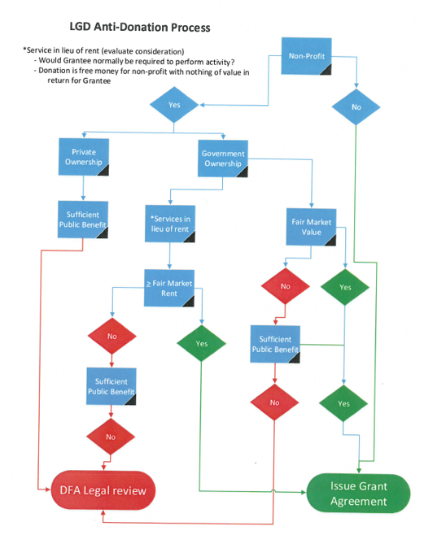
State anti-donation flowchart
This is a flowchart from the State outlining their process for determining Anti-Donation compliance.
Notice the lack of a link leading from DFA Legal review to Issue Grant Agreement? That’s not an omission: Legal review can be a long and complicated process.

Slide 17
Project
feasibility
State Grants expire in 2 years for equipment, 4 years for construction
New commercial construction is currently running about $1000-1400/sq ft.
Of the 120 current NPO grants, 86 are $200K or less
If your only funding is state capital outlay - An NPO pulling in ~$400K/session can feasibly support a construction project for ~$1.2M. This is an approximately 1,000 sq. ft. museum, social center, classroom, kitchen, etc.
If you have other funding than state capital outlay – Will your other funding sources approve of the City owning the building?
If not, this funding will only be usable for design, equip, or furnish
What is the end goal? Can it be phased?
Are you requesting land or designs for a building you will not be able to afford to later construct?
If any phase of the total project is more than ~3x your average allocation, you will be highly unlikely to complete this project
Notes:
ONC – Not for specific projects but overall goals
Depts is the best way
Council
Next slide – CC and State NPO

Slide 18
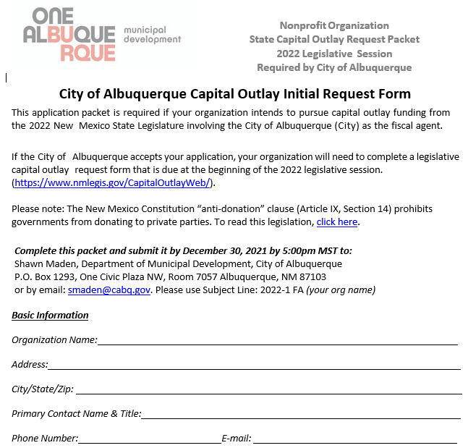
City fiscal agent application
Can be found at https://www.cabq.gov/municipaldevelopment/programs/state-capital-outlay-for-non-profits​
Return by email to smaden@cabq.gov
Please use Subject Line: 2025-1 FA (your Org name)
City’s Deadline to return to Shawn is 12/6/2024 5pm
Applications are sent to the Mayor’s Office for approval.
Notes:
ONC – Not for specific projects but overall goals
Depts is the best way
Council
Next slide – CC and State NPO

Slide 19
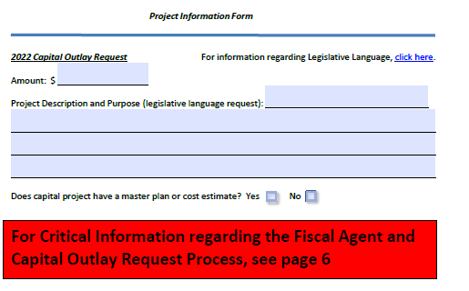
Application page 3
Legislative Language used, this is the “Scope” of the project, not a project description
Enter here exactly what you plan to enter on the State’s website, please!
“to furnish, equip, and purchase vehicles for a teen homeless shelter, including information technology, ovens, and freezers”
Notes:
ONC – Not for specific projects but overall goals
Depts is the best way
Council
Next slide – CC and State NPO

Slide 20
Scope vs. scope of services
The Scope of your project, as defined by the spending bill “legislative language”, is NOT the “Scope of Services” in your Use Agreement with the City.
The Scope of your project defines what the Capital Outlay may legally be used for. This is what is placed in your City FA Application and the Online Capital Outlay Portal. This is also referred to as “allocation language”.
i.e. to purchase and equip hot food delivery trucks in ABQ in Bernalillo County
The City may deny any requests that we deem not legally permissible by your legislative “Scope”, even if DFA/SBoF release the funds.
The Scope of Services in your Use Agreement is the description of the services that you will provide for the City in return for use of the equipment/facilities purchased by said Capital funds.
i.e. KindFolks shall shelter, feed, and support homeless teens, up to 5 at a time, at the rate of $30/person/day for the Family and Community Services Department of the City of Albuquerque. Feeding shall be 3 hot meals, support shall be access to social services, behavioral health, and tutoring…
Notes:
ONC – Not for specific projects but overall goals
Depts is the best way
Council
Next slide – CC and State NPO

Slide 21
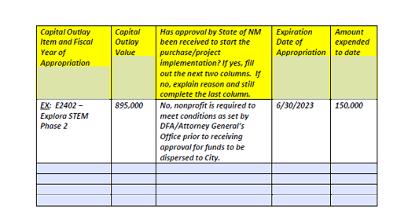
Application
Page 4
ALL previous Capital Outlay funding requests that have been signed into law by the Governor AND are still in process of being expended or approved.
Do not include projects/funding that have been completed.
Notes:
ONC – Not for specific projects but overall goals
Depts is the best way
Council
Next slide – CC and State NPO

Slide 22
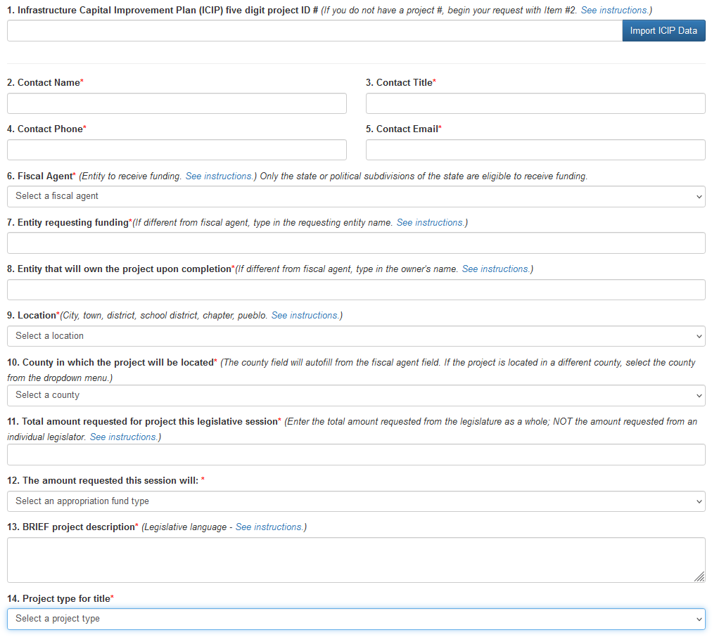
Online
application
This is mostly self-explanatory, but here are a few things to know:
Line 1 – Leave Blank
Line 6 – Albuquerque
Line 7 – Albuquerque
Line 8 – Albuquerque
Line 9 – Albuquerque
Unless outside City limits, then Bernalillo County
Line 13 – This is the “Legislative language” Scope of your project
to acquire, equip, furnish…in ABQ in Bernalillo County
Line 14 – Purchase/Equip/Furnish
Notes:
ONC – Not for specific projects but overall goals
Depts is the best way
Council
Next slide – CC and State NPO

Slide 23
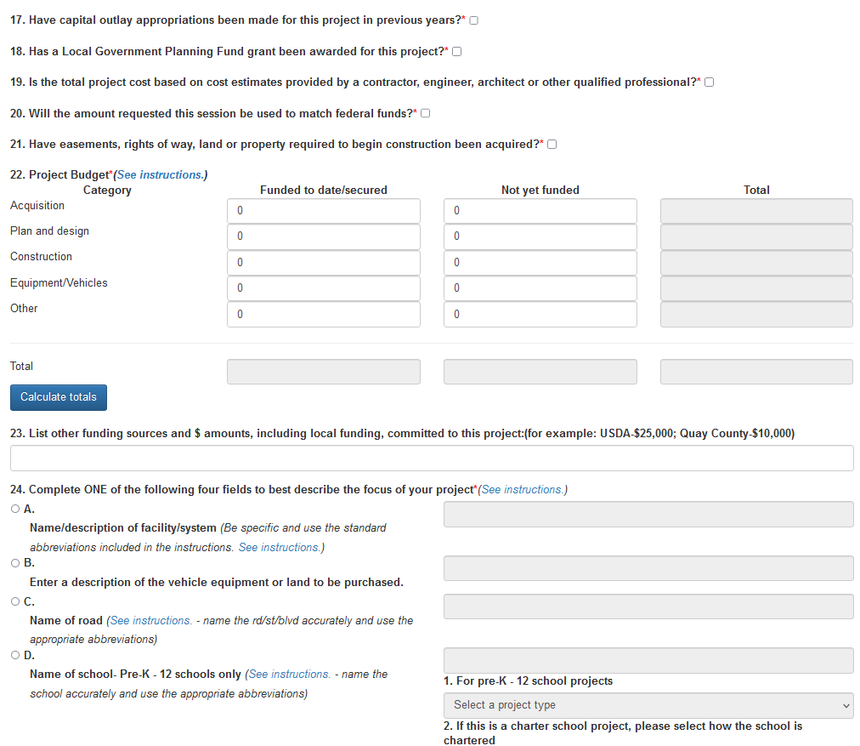
Online application
continued
Line 22 – You will only utilize the Equipment/Vehicles section
Line 24 – N/A Equipment/Vehicle purchase
Line 25 – You will only use Line B
Use their instructions!
Notes:
ONC – Not for specific projects but overall goals
Depts is the best way
Council
Next slide – CC and State NPO

Slide 24
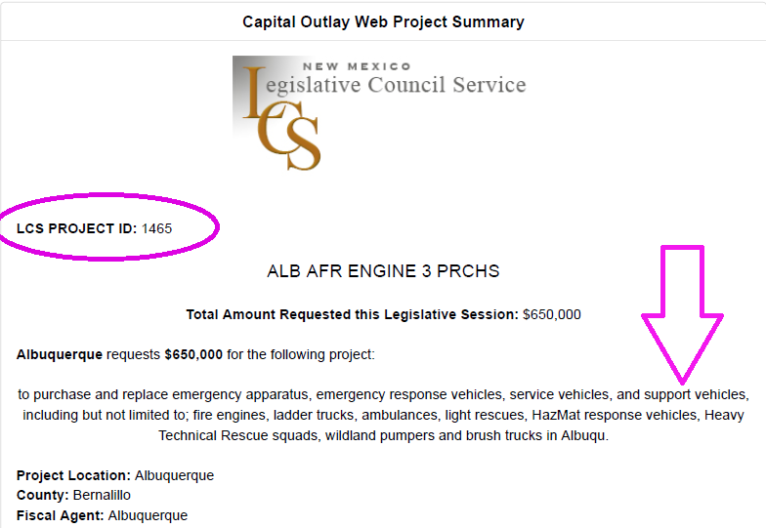
Email
The city
When asked to print the summary shown, please download as PDF and send it to smaden@cabq.gov using the same subject line 2025-1 FA (your Org name)
At a minimum, please email me the LCS Project ID number. This makes it much easier for me to track, as there are typically over 2000 entries in the bill.
Notes:
ONC – Not for specific projects but overall goals
Depts is the best way
Council
Next slide – CC and State NPO

Slide 25
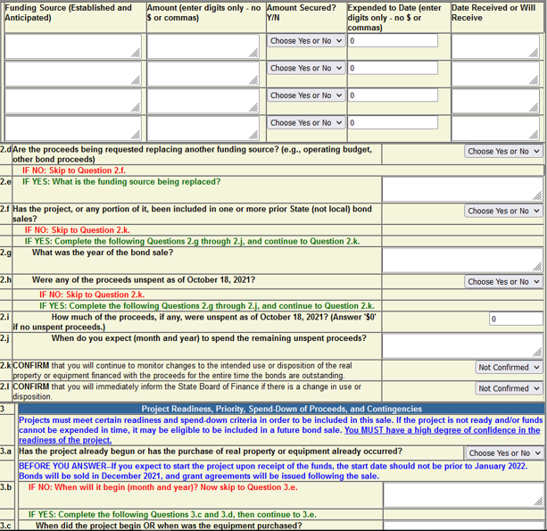
Dfa/sbof
questionnaires
They will follow up with additional questions in CPMS – The City handles these.
Prior to project inclusion for Bond Sale, DFA/SBoF will look into each project to assess compliance. Projects not meeting requirements will not be included in Bond Sales until all proof is provided.
This ALWAYS includes Use Agreements/Contracts with City.

Slide 26
The wait, a.k.a “where’s my money”
Even if the bill passes permitting your Organization to receive Capital funding, those funds WILL NOT be released until DFA/SBoF ensures the project meets State Law
You will need to be proactive, but patient, regarding the process of obtaining funding, especially with the upcoming session
Funds are approved for sale in an upcoming bond by DFA/SBoF after their requirements are met
Anti-donation refers to the prohibition in the NM Constitution that prevents the government (including the City) from giving money or anything of value to any private entity – even a non-profit entity
Notices of Obligation are required - these add to the time, and may further limit what can be done
Notes:
CR established request amounts, priorities, rules
CIP Ordinance sets timelines
Funds available approx. Mar 2024
Lots of money = lots of rules and direction
Next slide – how projects chosen

Slide 27
Art in public places 1%
1% for Art in Public Places (AIPP) is automatically deducted by State Law.
Amounts allocated by and listed in the passage of the bill DO NOT take this amount into account, the 1% is taken from this amount.
e.g. If you are sponsored for $120,000 in the final bill, the total amount available for your project will be $118,800.
The City has no control over this, it is removed from all our projects as well, including non-State Capital such as the City’s General Obligation Bond program.

Slide 28
Questions?
Thank you for attending!

